Slide 1
ONLINE FOOD ORDERING SYSTEM
NIVETHA SANKARASUBRAMANIAN [RA2011003010172]
AMAAN ALI KHAN B [RA2011003010160]
PRAVEEN KRISHNAKANTH S [RA2011003010152]

Slide 2
Abstract

Slide 3
The Online Food Ordering System is a web-based application that simplifies the process of ordering food from various restaurants. It offers customers a convenient platform to browse menus, place orders, and make online payments. With personalized accounts, search options, and detailed menus, customers can easily customize their orders and select delivery or pickup options. The system provides restaurant owners with an intuitive dashboard to manage menus, track orders, and communicate with customers. By automating the ordering process, minimizing errors, and enabling online payments, the system enhances efficiency and customer satisfaction. Overall, the Online Food Ordering System revolutionizes the food ordering experience by providing a user-friendly and efficient platform for customers and restaurant owners alike.
Overall, the Online Food Ordering System revolutionizes the traditional food ordering process, providing a user-friendly and efficient platform for customers to order food and for restaurant owners to manage their operations effectively. With its convenient features and seamless functionality, the system enhances the online food ordering experience, making it more convenient, reliable, and enjoyable for all parties involved.

Slide 4
Requirements

Slide 5
Languages: PHP, SQL
RDBMS: Online MySQL
Development Platform: xampp

Slide 6
Problem Statement

Slide 7
The People must be present condition in taken food from hotel that means People had to compulsion of goes to hotel. It is a growing trend especially in urban areas and on college campuses that allows people to order from restaurants featuring interactive menus, by use of their Internet connection.
The traditional food ordering process is outdated and cumbersome, relying on phone calls and paper menus. This leads to inefficiencies, such as miscommunication, long wait times, and limited menu visibility. Additionally, restaurants struggle to manage orders efficiently and gather customer data for business insights.
There is a need for an online food ordering system that simplifies the ordering process, enhances customer experience, and provides restaurants with a digital platform to streamline operations and improve profitability.

Slide 8
Objective

Slide 9
Our objective is to develop an efficient and user-friendly online food ordering system that enhances customer experience and streamlines operations for restaurants.

Slide 10
Scope and Applications

Slide 11
The scope of an online food ordering system includes the development of a digital platform accessible via web or mobile applications for customers to browse menus, place orders, and make payments. It also encompasses features like order tracking, delivery management, and customer feedback. The system's applications are wide-ranging and can be utilized by various stakeholders in the food industry, including restaurants, cafes, food trucks, and delivery services, to streamline their operations, increase efficiency, and improve customer satisfaction. It provides convenience to customers by allowing them to order food from a wide range of options and have it delivered to their desired location, enhancing their overall dining experience.

Slide 12
Front End(UI) Design

Slide 13
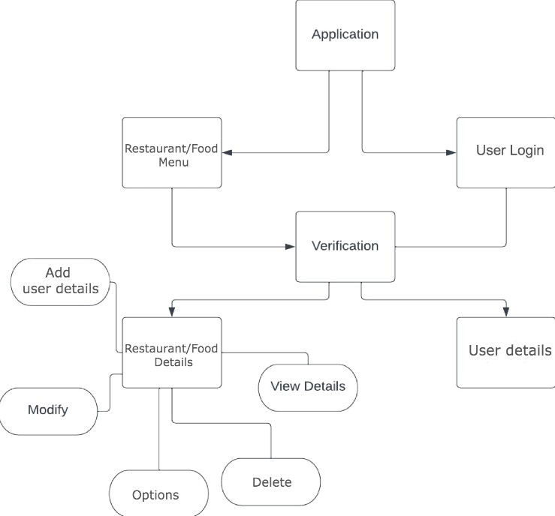

Slide 14
Back End (Database) Design

Slide 15
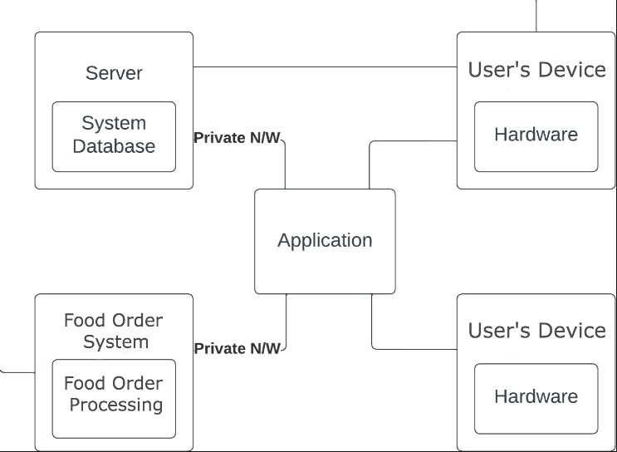

Slide 16
Use Case Diagram

Slide 17
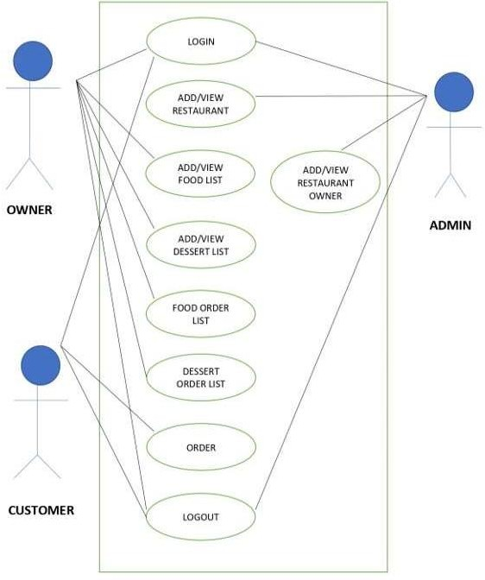

Slide 18
Entity Relationship Diagram

Slide 19
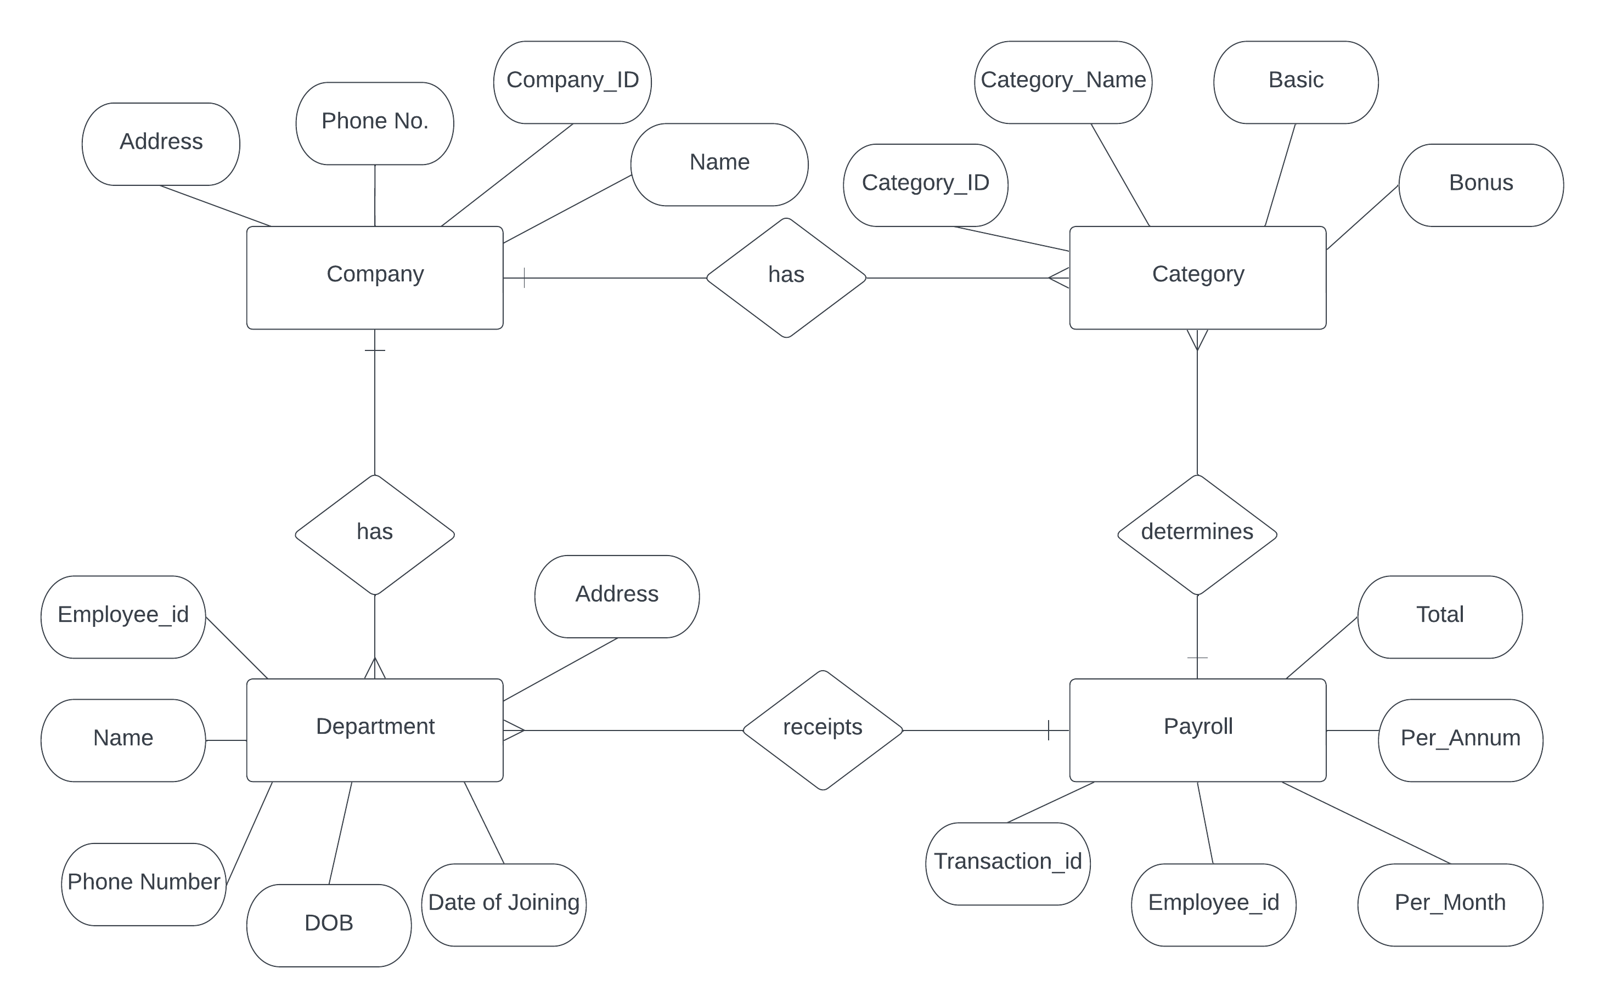

Slide 20
Modules & Functionalities

Slide 21
Search and Menu
Estimated delivery time
Payments
GPS Tracking
Review and Rating

Slide 22
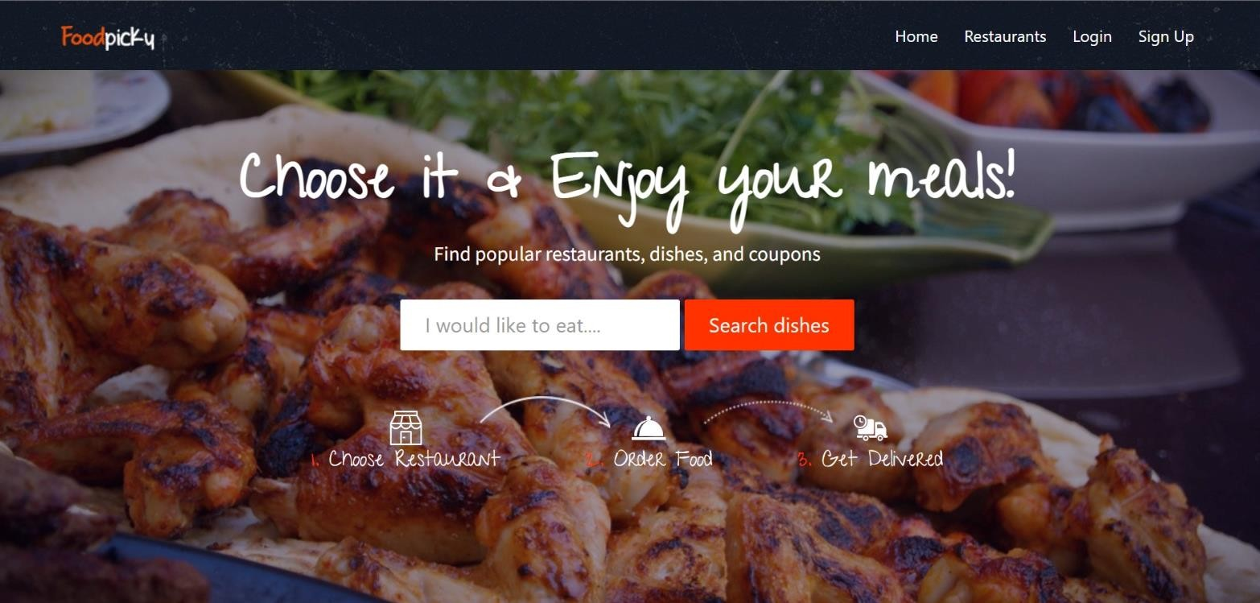
Home Page

Slide 23
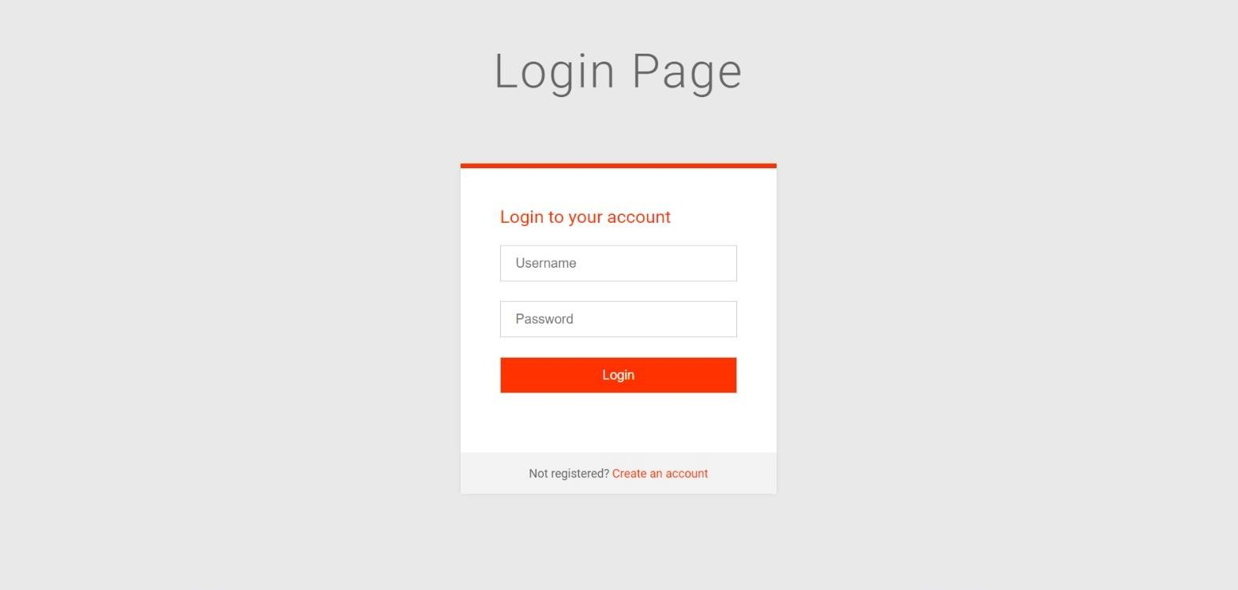
Login Page

Slide 24
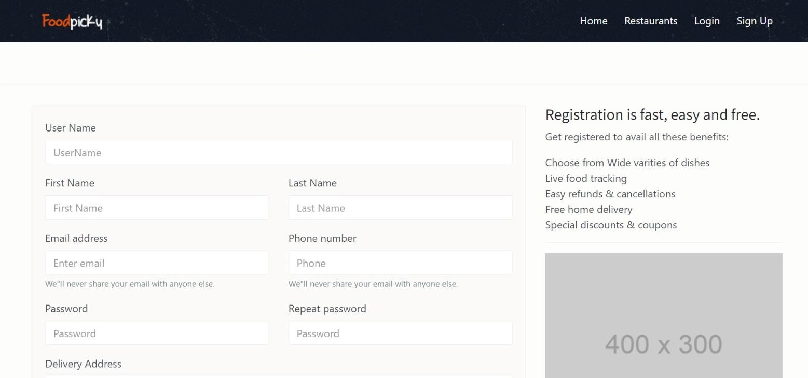
Create Account Details

Slide 25
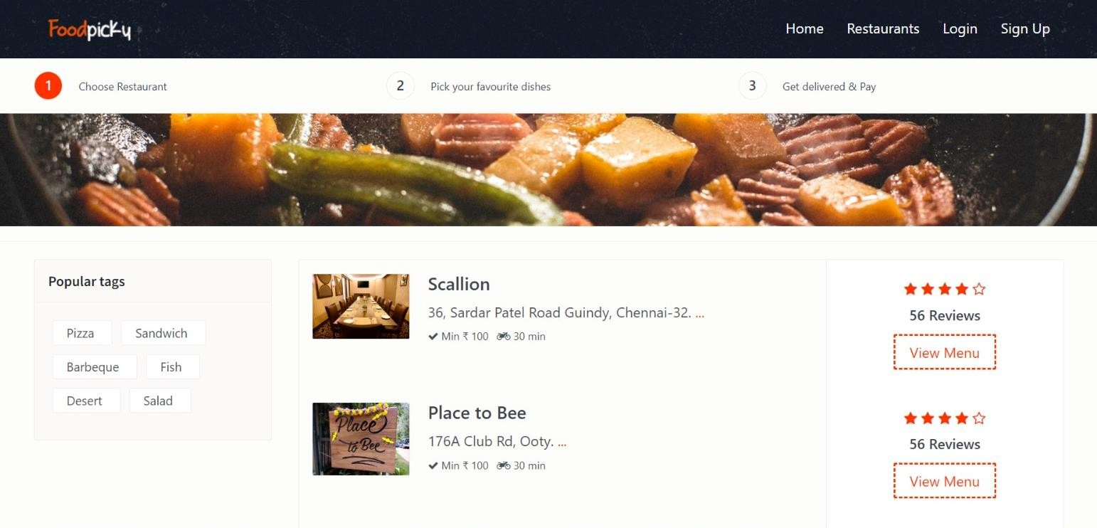
Display Restaurant Details

Slide 26
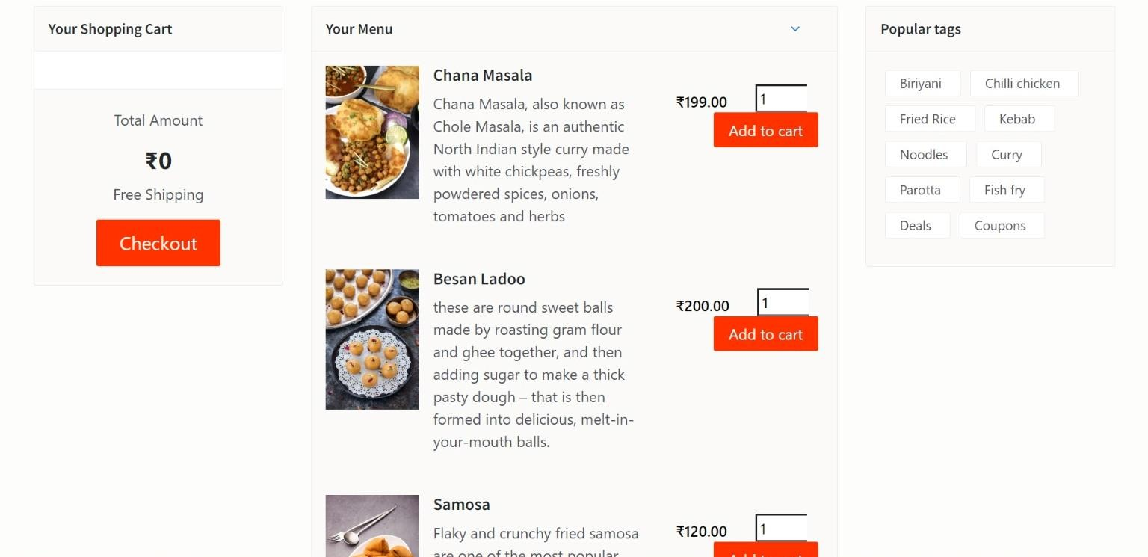
Display Food Details

Slide 27
Conclusion

Slide 28
In conclusion, the online food ordering system is a convenient and efficient way for customers to order food from their favorite restaurants. It provides a user-friendly interface, quick ordering, and payment options. The system also benefits the restaurants by reducing errors in orders, improving efficiency, and increasing sales.

Slide 29
Future Enhancements

Slide 30
In the future, the following enhancements can be made to the online food ordering system:
Integration with third-party services: OFOS Integration with third-party delivery services like Uber Eats, Grubhub, and DoorDash to increase the delivery options available to customers.
Implementation of a recommendation system that suggests menu items to customers based on their previous orders.
Implementation of a loyalty program that rewards customers for frequent ordering.
Integration of a real-time chatbot to handle customer queries and complaints.
Integration of a review and rating system that allows customers to rate their experience and provide feedback to the restaurant.

Slide 31
References

Slide 32
https://www.researchgate.net/publication/321844341_Online_Food_Ordering_Syste m
https://www.trioangle.com/blog/modules-to-be-included-to-develop-online-food- ordering-script/
https://www.ijraset.com/research-paper/online-food-ordering-system
https://www.geeksforgeeks.org/food-ordering-system-in-c/
https://www.deliverect.com/en/blog/online-food-delivery/how-does-food-delivery- apps-algorithm-work
https://www.scribd.com/document/515271401/Objective-of-Food-Ordering-System

